Slide 1


Data Engineering
Neil Ranly, PhD
Air Force Institute of Technology

Slide 2
Overview
Course Objective
Data Definition
Motivation
Data Engineering Definitions
Recap

Slide 3
Course Objectives
Learn and to think about data at a deep level
Recognize data as a critical resource
Comfortable working with all types of data
Support the curation of data efficiently and effectively in systems
Utilizing engineering principles

Slide 4
Data Definition
How do you define data? What is data?
Is data a requirement to learn?
Is data a requirement to perform science?
Science : the intellectual and practical activity encompassing the systematic study of the structure and behavior of the physical and natural world through observation and experiment

Slide 5
Data Definition
Can we, as humans learn, without data? If so, what do you call the input into the learning process?
How did we learn before digital-computers?
How did we learn before the printing-press, books, and writing?
How did we learn before drawings and spoken words?
Do animals that don’t speak and don’t interact with humans learn? If so, how?

Slide 6
Data Definition
Are the pictures and the words on the screen data?
Is a physical book data?
What about the whiteboard?
Is the empty spot on the whiteboard data?
Are your and my clothes data?
Is DNA data?

Slide 7
Data Definition
Is programming computer code data?
Is an executable application data?
Are mathematical theories and trained models data?

Slide 8
Data Definition
Data: physical matter interpretable by compute-engines
By compute-engines I include both humans and machines
Digital Data: matter artificially construed to symbols from a finite alphabet (often zero-one-based, binary digital data) to support system processing
Analog Data: data that is not digital, matter not-construed artificially to an symbols
Digital Data has a very nice property of supporting efficient copying, enabling mass consumption

Slide 9
Data is vs Data are
I define data as uncountable (physical matter), thus I use "data is" as opposed to "data are"
Some journals and organizations may define data as countable
In your project report and presentation, just be consistent in your writing

Slide 10
Structured Data
Structured Data: matter artificially construed to support efficient and effective communication
Notice that this depends on who is receiving the data; most machine-trained models do not understand natural language, thus communication is not effective (the models do not work) when trying to send in the natural language inputs; other models, such as ChatGPT can efficiently handle natural language prompts assuming that user uses proper grammar and common vocabulary (the structure)
In other words, "structured" refers to a property of data that the receiver can efficiently and effectively interpret the data

Slide 11
Abstractions
Many define "Structured Data" from the perspective of a simple machine
Often structure data to represent real-world physical objects, events, money, and mathematical theories for efficient machine processing
Abstraction (from the Latin abs, meaning away from and trahere, meaning to draw) is the process of taking away or removing characteristics from something in order to reduce it to a set of essential characteristics
"the process of ignoring characteristics of patterns that are not needed in order to focus on the ones that are. This process also involves filtering out specific details to create a representation of what is being solved"
Abstraction
Abstraction can be viewed as summarization
Helps manage complexity, often using generalization, creating a generalized representation of something
May be viewed as a requirement of structured data (since in most cases we don't need all the details)

Slide 12
Motivation
Learning requires data
Data is a foundation of all science
Curation of quality data often requires intentional coordination between many systems and stakeholders in a highly-interactive universe

Slide 13
Motivation
Data is valued
Improve decisions to take care of planet
Improve decisions to take care of ourselves
Improve resource allocations decisions
Big Business
Google's mission is "to organize the world's information and make it universally accessible and useful"
Microsoft's mission is "to empower every person and every organization on the planet to achieve more {through information technology and services}"
Notes:
https://www.google.com/search/howsearchworks/our-approach/#:~:text=Google's%20mission%20is%20to%20organize,height%20of%20the%20Eiffel%20Tower.
https://www.microsoft.com/en-us/about#:~:text=Our%20mission%20is%20to%20empower,the%20planet%20to%20achieve%20more.

Slide 14
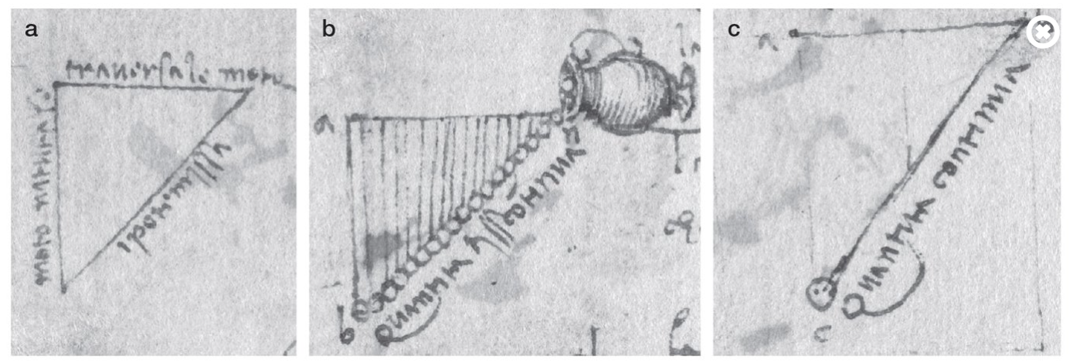
Motivation
Theory of Gravity, data is a fundamental aspect of experimentation
https://www.caltech.edu/about/news/leonardo-da-vincis-forgotten-experiments-explored-gravity-as-a-form-of-acceleration
Notes:
We employ experiments to generate data.

Slide 15

Motivation
Structured Data
Theories
Decisions
Note that our understanding and decisions co-exist in world, thus contribute to data
Notes:
https://www.google.com/search/howsearchworks/our-approach/#:~:text=Google's%20mission%20is%20to%20organize,height%20of%20the%20Eiffel%20Tower.
https://www.microsoft.com/en-us/about#:~:text=Our%20mission%20is%20to%20empower,the%20planet%20to%20achieve%20more.

Slide 16
Motivation
Structured Data
Theories
Decisions
Improve the management of data, represented in all the arrows
Notes:
https://www.google.com/search/howsearchworks/our-approach/#:~:text=Google's%20mission%20is%20to%20organize,height%20of%20the%20Eiffel%20Tower.
https://www.microsoft.com/en-us/about#:~:text=Our%20mission%20is%20to%20empower,the%20planet%20to%20achieve%20more.

Slide 17
Motivation
General Relativity
Quantum Mechanics
Newton
Da Vinci
Development of more-insightful, higher-level theories
Notes:
Theories may not be perfectly compatible. I.e., some abstractions used in one theory may not be used in another theory. The usefulness of abstractions can surface from their ability to concisely describe causality in the world within theories.

Slide 18
Motivation
Strategic
Operational
Tactical
Physics and Math
How do we make informed strategic defense decisions?
Notes:
I.e., different abstractions may be used in different areas layers of problems. The usefulness of abstractions can surface from their ability to provide insight for decisions.

Slide 19
Motivation
Challenges
Making sense in a constantly changing environment, continuous learning
Quality data in highly manipulated environments to distill causality vs correlation
Notes:
https://www.google.com/search/howsearchworks/our-approach/#:~:text=Google's%20mission%20is%20to%20organize,height%20of%20the%20Eiffel%20Tower.
https://www.microsoft.com/en-us/about#:~:text=Our%20mission%20is%20to%20empower,the%20planet%20to%20achieve%20more.

Slide 20

Motivation
Data is all-around us
Up to us to how we use it

Slide 21
Engineering Definition
Engineering : use of scientific principles within the system build and system execution process
Careful Observation
Rigorous Skepticism
Testability
Formulation of a question
Hypothesis
Prediction
Analysis
Replication
External review
Data recording and sharing
Instrumentation

Slide 22

Definitions
“Data Engineering is the development, implementation, and maintenance of systems and processes that take in raw data and produce high-quality, consistent information that supports downstream use cases, such as analysis and machine learning. Data Engineering is the intersection of security, data management, DataOps, data architecture, orchestration, and software engineering. A Data Engineer manages the data engineering lifecycle, beginning with getting data from source systems and ending with serving data for use cases, such as analysis and machine learning.”

Slide 23

Definitions
“Data engineering is the process of transforming raw data into a form that can be easily processed and analyzed by computer systems. It involves a set of activities that are performed to design, develop, test, and maintain data pipelines that help organizations make sense of the large amounts of data they collect.”
This Photo by Unknown author is licensed under CC BY.
ChatGPT3.5

Slide 24
Definitions
Similar response from Google Bard, one response stressed data “Infrastructure.”
https://bard.google.com/

Slide 25
Data Engineering Definitions
The high-level tasks of data engineering can be broken down into the following:
Data Collection
Data Storage
Data Processing
Data Integration
Data Modeling
Data Serving
Throughout the entire data engineering process, data engineers must also ensure that the data is secure, compliant with relevant regulations, and meets the needs of the end-users.
This Photo by Unknown author is licensed under CC BY.
ChatGPT3.5

Slide 26
Data Engineering Definitions
The high-level tasks of data engineering can be broken down into the following:
Data Collection
Data Storage
Data Processing
Data Integration
Data Modeling
Data Serving
The first step in data engineering is to collect the data from various sources. The data may come from internal sources like databases, spreadsheets, sensors, social media, or experiments.

Slide 27
Data Engineering Definitions
The high-level tasks of data engineering can be broken down into the following:
Data Collection
Data Storage
Data Processing
Data Integration
Data Modeling
Data Serving
Once the data is collected, it often needs to be stored in a way that is easily accessible and scalable. This requires selecting an appropriate storage solution such as relational databases, NoSQL databases, data lakes, or data warehouses.

Slide 28
Data Engineering Definitions
The high-level tasks of data engineering can be broken down into the following:
Data Collection
Data Storage
Data Processing
Data Integration
Data Modeling
Data Serving
After the data is stored, it may need to be cleaned, transformed, and enriched to make it suitable for analysis. This may involve tasks such as removing duplicates, standardizing data formats, handling missing values, and performing calculations.

Slide 29
Data Engineering Definitions
The high-level tasks of data engineering can be broken down into the following:
Data Collection
Data Storage
Data Processing
Data Integration
Data Analysis
Data Serving
In many cases, data comes from multiple sources and needs to be combined into a single dataset for analysis. This requires integrating the data from different sources and ensuring that it is consistent and accurate.

Slide 30
Data Engineering Definitions
The high-level tasks of data engineering can be broken down into the following:
Data Collection
Data Storage
Data Processing
Data Integration
Data Modeling
Data Serving
Data engineers work with stakeholders and business analysts to build data models to represent data
Data engineers work with data scientists to communicate data for machine-trained models and develop algorithms to extract insights from the data

Slide 31
Data Engineering Definitions
The high-level tasks of data engineering can be broken down into the following:
Data Collection
Data Storage
Data Processing
Data Integration
Data Modeling
Data Serving
The final step is to present the data in a way that is easy to understand and interpret, often involves creating visualizations and dashboards that help users interact with the data and gain insights from it.

Slide 32
Big Picture Questions
What role will data have in the future to support the Air Force?
In what ways is data used in relation with the operation of artificial intelligence capabilities?

Slide 33
Recap
Data
Digital Data
Analog Data
Structured Data
Abstractions
Engineering Principles
Data Engineering

